Slide 1
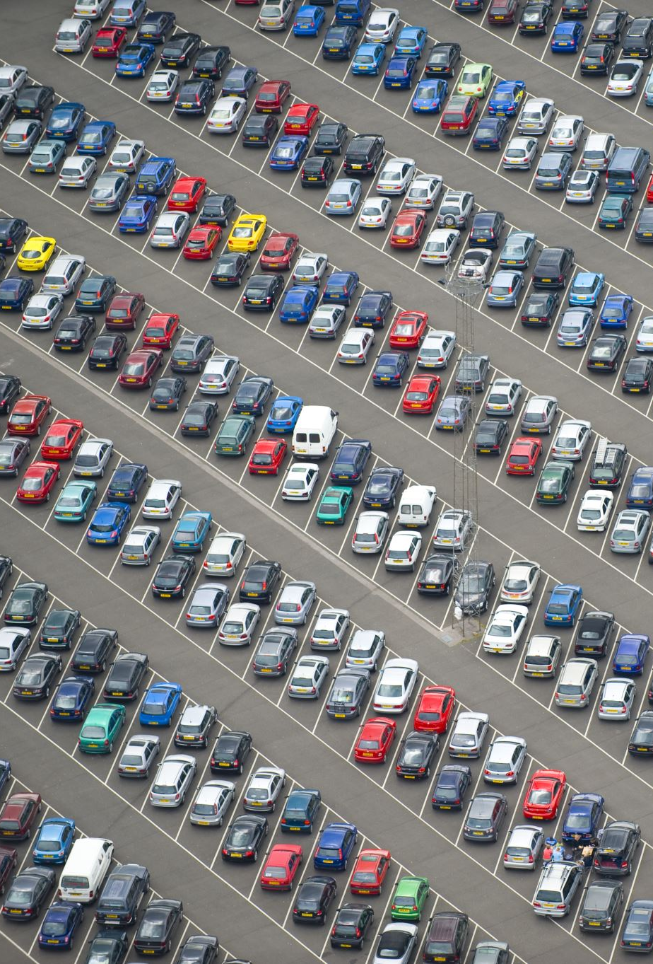
Lariat Rent-A-Car Future Fleet Outlook
Nathanael Washington

Slide 2
Future Operations Outlook
Goal #1
Maximizing Revenue
Playing to our strengths by investing in new fleet for high performing branch location
Goal #2
Cutting Cost
Context
2018 Cost $33 M 2018 Net Revenue $31 M
Investing in the highest performing models to maintain lower yearly cost
Consider Getting rid of higher cost, lower revenue vehicles

Slide 3
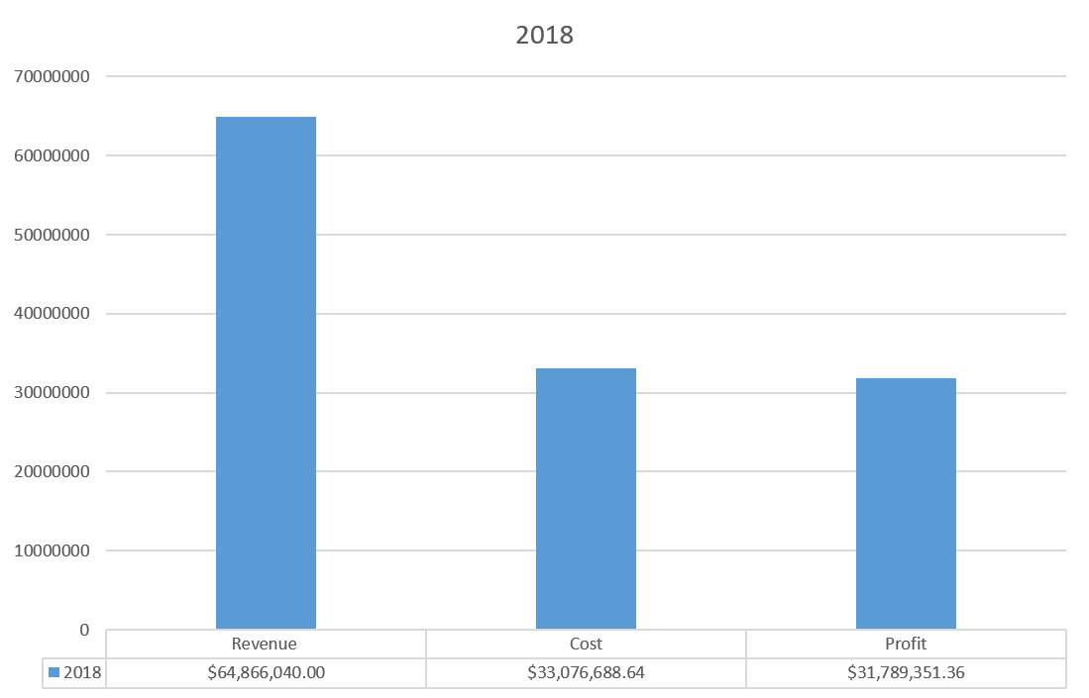
2018 Lariat Rent-A-Car

Slide 4
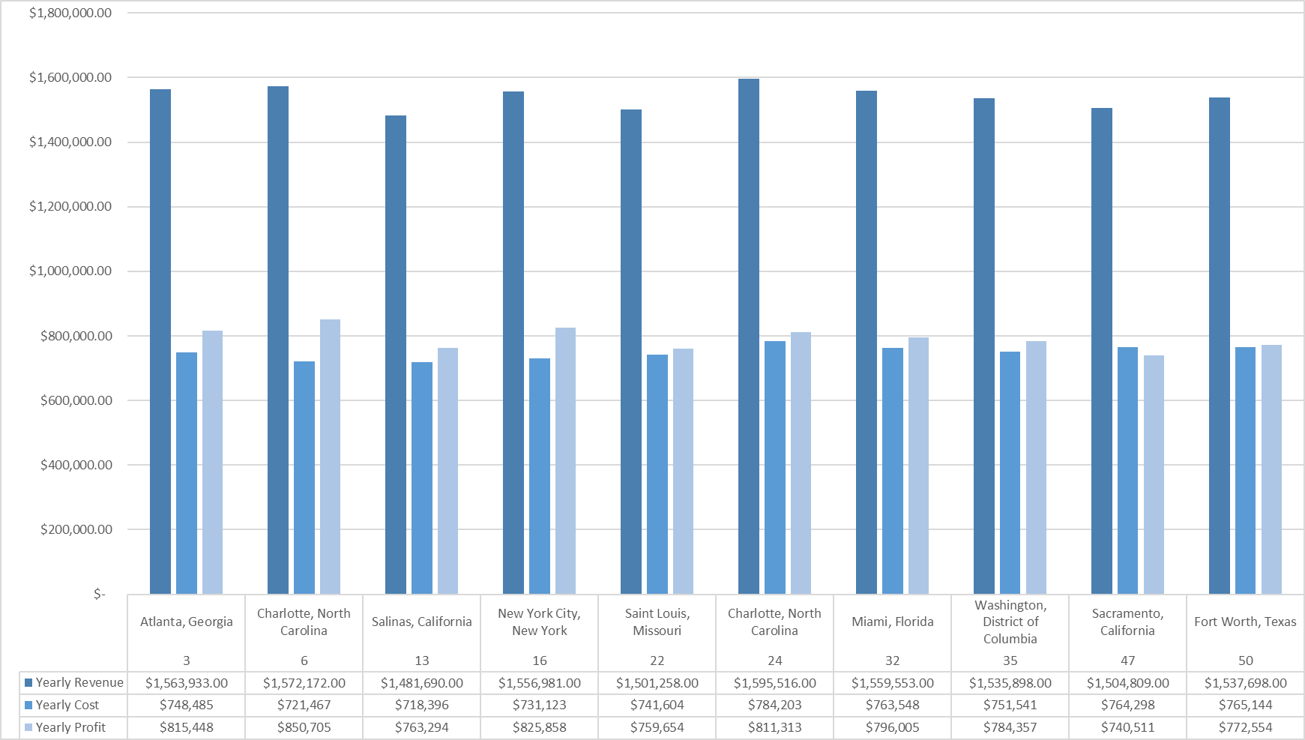
2018 Top 10 Performing Branches

Slide 5
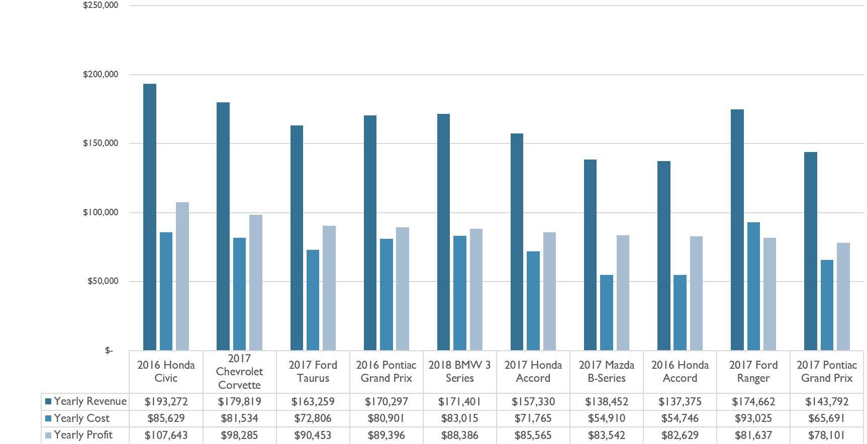
Top 10 Performing Vehicles

Slide 6
Strategy 1: Increase the average rental price by 10%
Strategy 2: Rental increase of 20% Through Customer Incentives
Strategy 2: Increase the fleet number by 250 vehicles and Rental increase of 20%
Proposed Strategies for Increased Revenue

Slide 7
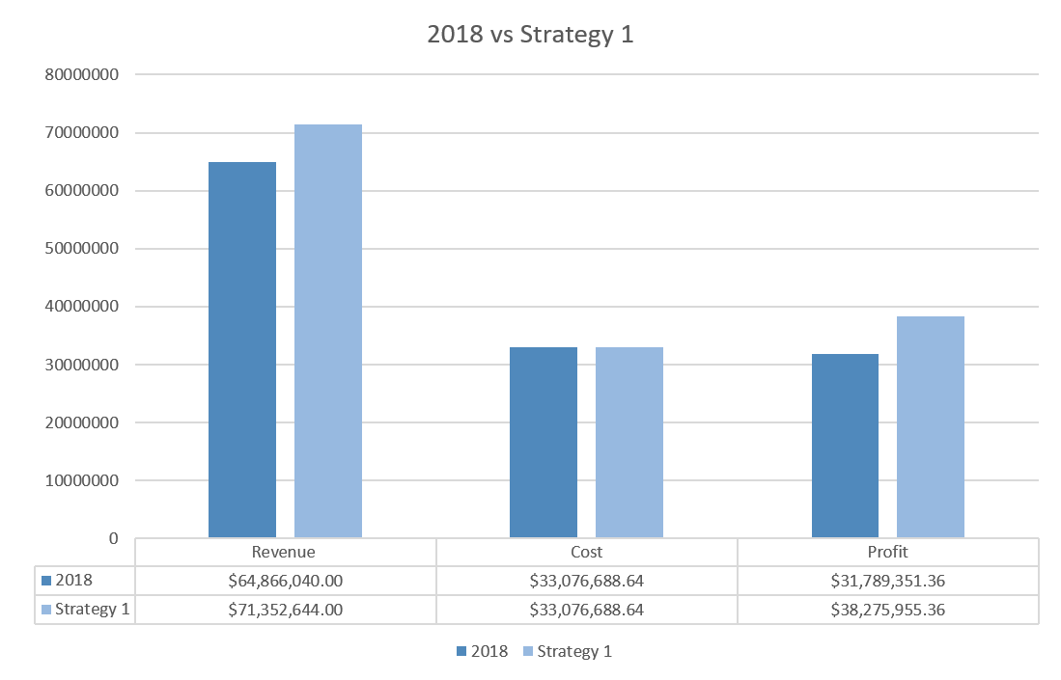
Strategy 1: Increase the average rental price by 10%

Slide 8
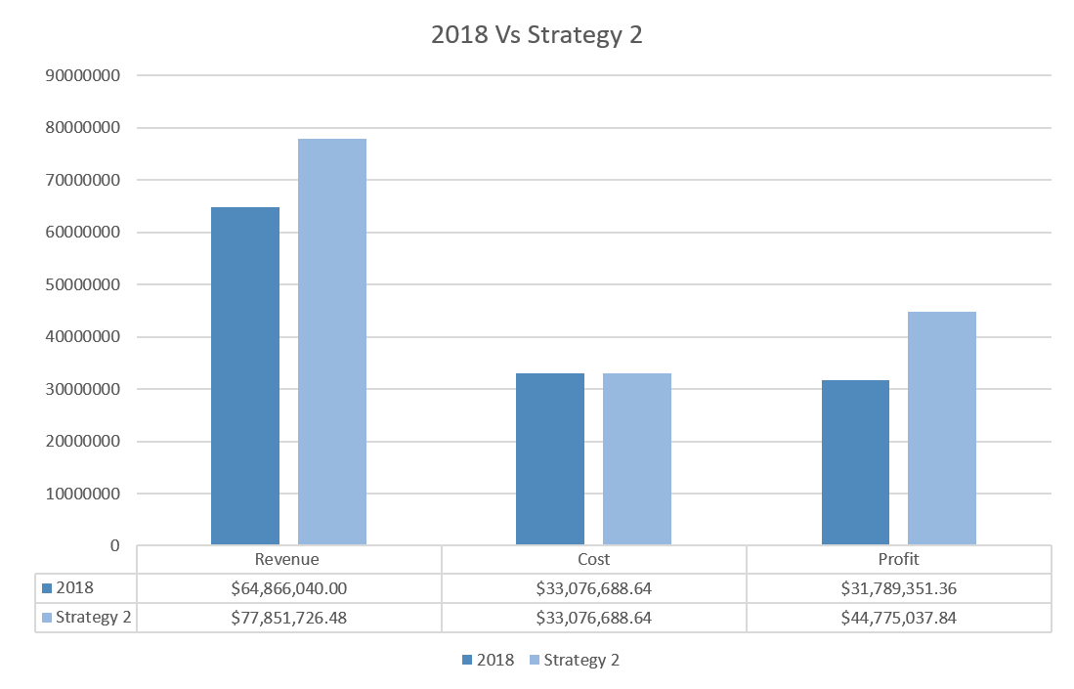
Strategy 2: Rental Increase of 20% Through Customer Incentive

Slide 9
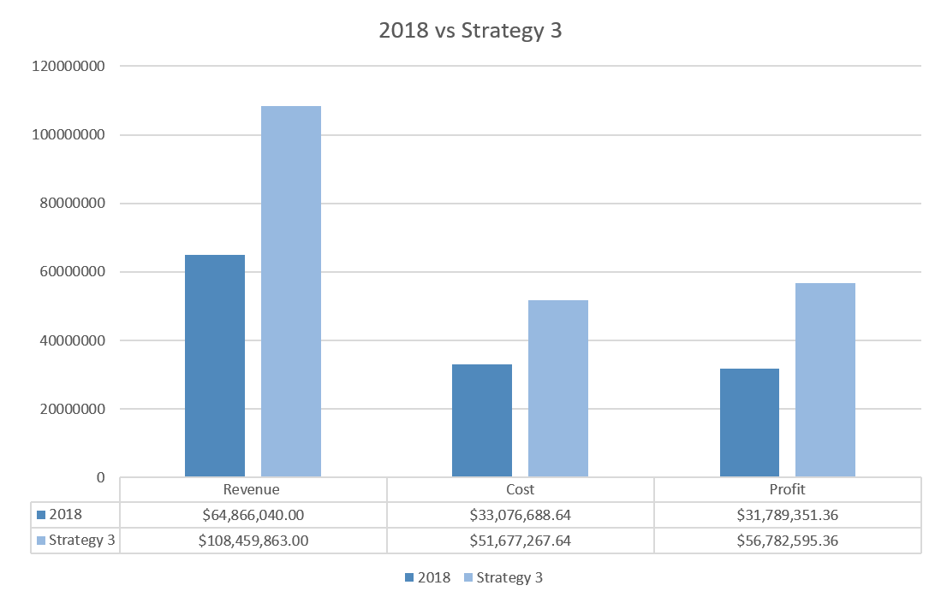
Increase the fleet number by 250 vehicles and Rental increase of 20%

Slide 10
In Summary
An Increase of average rental price by 10% can potentially increase revenue $6 M
An Increase in the number of rental transactions by 20% through customer incentive $12.9 M
Increasing the fleet number by 250 vehicles of the Top 10 Performing Vehicles increases Revenue +$43.5 M

